Slide 1


EMOTION SCIENCE
Psyc 3310

Slide 2
Lab 5
Presenting research and running the testing session

Slide 3
Presenting Research
You’ll be presenting the results of your research projects in your groups in the week beginning the 23rd of October
Today:
  What you should cover
  Some tips for making your presentation easy to follow
  Based on a presentation by Dr Louise Ewing (excellent public speaker!)

Slide 4
Why present research?
Communication!
  To other researchers: communicate findings, influence new research, form collaborations
  To the general public: explain important ideas, give returns for research funding, promote importance of research area & science in general
Think about your audience
  What do they already know?
  What will they understand easily?
  What are they interested in?

Slide 5
Format of your presentation
Presentations should loosely follow the format of a paper:
  Introduction (motivate your research)
  Present your hypotheses or research questions
  Explain your method
  Present your results
  Discuss what these results mean for your hypotheses/research questions, for state of knowledge in the area more generally

Slide 6

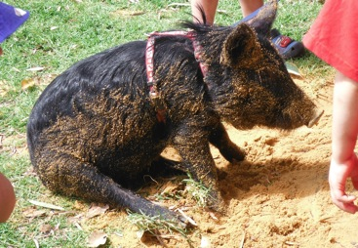
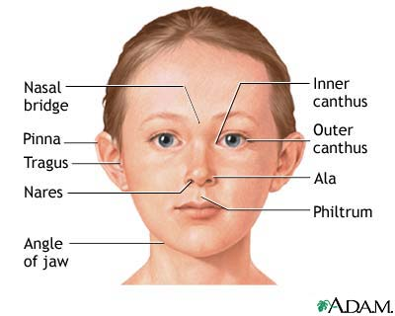
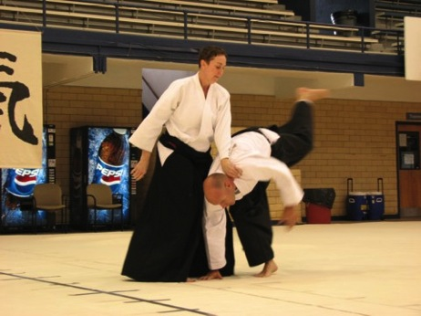


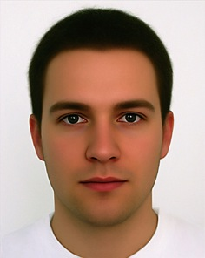



Maximize Interest
Use pictures/videos

Slide 7
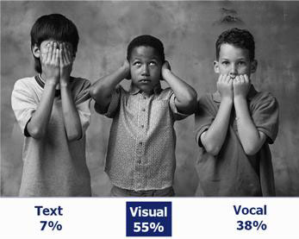
Maximize Interest
Use pictures/videos
  But keep it relevant
Use colour

Slide 8
Maximize Interest
Use pictures/videos
  But keep it relevant
Use colour

Slide 9
Maximize Interest
Use pictures/videos
  But keep it relevant
Use colour
  But keep it legible
Use humour (or not!!)
  And be yourself!
  People will go in believing you can do research

Slide 10



Maximize Understanding
Remember your audience
Use examples
  Analogies
  Pop culture references!

Slide 11
Introduction
Time (and attention) limited!
Simplify your scope
  What is essential?
Tell one story, clearly
Back up your main points with references (Ewing, 2014)

Slide 12
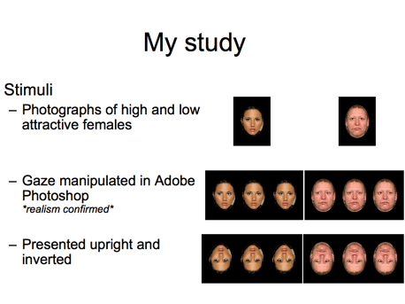
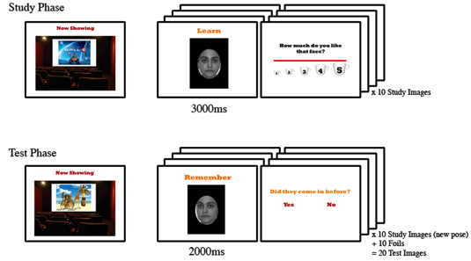
Method
Pictures Pictures Pictures
Run a demo
Only mention the essentials
  Age, gender, ethnicity…?
  Inter-stimulus intervals, task order…?

Slide 13
Results
Don’t try and fake it
Make the results part of your story
  Remind people what you were expecting
Show statistics sparingly
  Emphasize meaning
Notes:
Don’t try and fake it…
If you don’t understand it, I promise they won’t!

Slide 14
Results
Graphs are great… make sure people understand them
  Use appropriate colours
  and sizes
  Talk the audience through the axes

Slide 15
1) Does angry expression increase perceived strength
*
ns
Perceived strength
Expression

Slide 16
Don’t overload your audience
Limited information on slides
  Especially text
Present things in order of
importance
AA
Notes:
AA = avoid acronyms

Slide 17
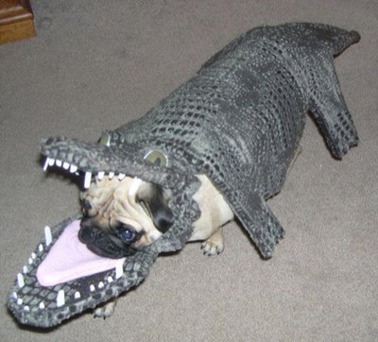
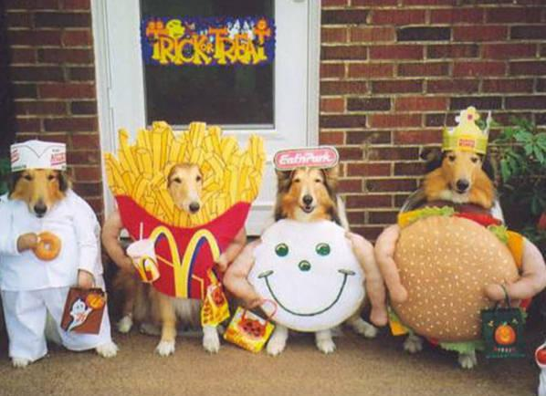
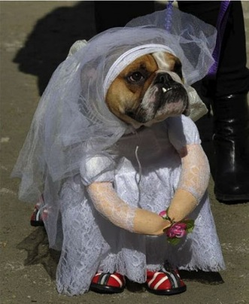
Lou’s tips to avoid DISASTER
Avoid irrelevant pictures
Animate your bullet points
One legible font
Be prepared
  Always be in the room 10 minutes before you expect anyone else
  Check that your slides work ok
Think about your delivery
Notes:
Think about your delivery
Get nervous and normally rely on notes?
Get nervous and speak really quickly?

Slide 18

Let’s see an example from Steve Jobs
https://www.youtube.com/watch?v=9hUIxyE2Ns8

Slide 19
Learning from Steve
Quick discussion: What was good about his presentation?
Slide design?
Delivery?

Slide 20
Running the testing session
Testing can start this coming Monday!
Data collection must finish by 5pm Monday 9/10
Remember that the last week will get very busy – book in early!
Quick reminder
  Each of you will recruit 6 participants
  Age >= 18
  Lived in Caucasian-majority country for 5 years or more
  Testing from 9am – 5pm only

Slide 21
Scheduling
2 rooms available for booking
  Room 1 (Main Psych Building Rm 103)
  Room 2 (Main Psych Building Rm 104)
Room booking is done using Google calendar (https://www.google.com/calendar)
  Account: 3310emosci@gmail.com
  Password: 33102017

Slide 22
Starting the session
Each session = ~40 minutes
Each slot starts on the hour – so stay on time!
  If your participant is more than ten min late, you will need to re-book.
Get participants to arrive 10 min early where possible to do info & consent forms
  Store them securely (designated box in testing room)

Slide 23
Running the session
Follow testing procedure on LMS (and copies in testing room)
Computer setup:
  Website for your study: http://uwa.qualtrics.com/jfe/form/SV_06O18XgxjwkwQKx
  All instructions and randomization have been programmed and automated ☺. You just need to launch the study using the url bookmark in Safari
  Brightness turned up to full
  Webpage is maximized to fullscreen

Slide 24
Participant sheet
A participant sheet is provided in each testing room
Please fill in the date, time, and your name in the sheet
There is a “Remarks” column for you to note down any observations about the participant or problems (Recall last week’s lab!).
A unique participant code is also provided for each entry, the testing program will prompt you to enter the code before the start of the study. This is so that we can match the details on the sheet to the data collected by the program.

Slide 25
The tasks
Face tasks
  Rating resemblance to anger in neutral male faces
  Rating perceived strength in male faces that vary in expressions
  Rating perceived strength in female faces that vary in expressions
Demographic questionnaire

Slide 26
What to say while testing
The testing procedure should be kept consistent
Follow the script (on LMS and in testing room) to make sure you have covered all information
Don’t tell participants too much! Can affect their results if they know what you are looking for beforehand.

Slide 27
Debrief
Give participants short verbal run-down and answer questions
Debrief outside the testing room!
Remind participant not to reveal details to other potential participants!

Slide 28
Testing Location
Recommend meeting participants at reception/first floor stairwell!
FaceLab is generally open, but you may need a key – can borrow one from Psych reception
  Remember this is a working lab/office! Take care of the equipment and don’t leave the room open and unattended
  If you get the key out, return it immediately on finishing! You’ll be held responsible for the lab while you have the key
  If you’re done and no-one else is using the room, get the key and lock up.

